Slide 1
The Schlieffen Plan
Germany’s secret Schlieffen Plan called for seven of Germany’s eight field armies to attack France through Belgium at the start of any war, regardless of cause. German military strategists thought that the diplomats had put them in an untenable position of having to fight on multiple fronts at the same time with unreliable allies. The Schlieffen plan was their answer.

Slide 2
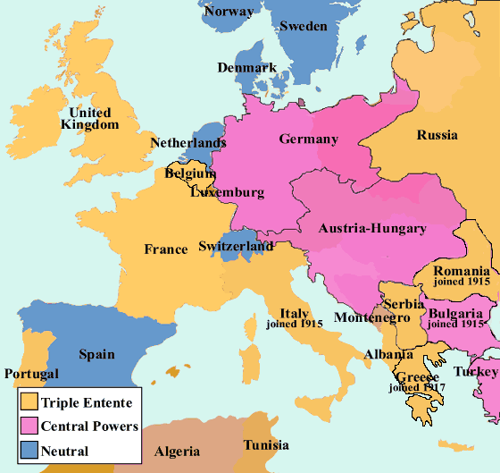
Germany “Surrounded”
The German Army saw dangers in this map of the 1914 alliances. They saw an industrial, modern France to their west and a large rearming Russia to the east. They also knew that Britain’s Royal Navy would likely dominate the North Sea. Because those three states were allied, the Germans assumed that any war with one would become a war with all.

Slide 3
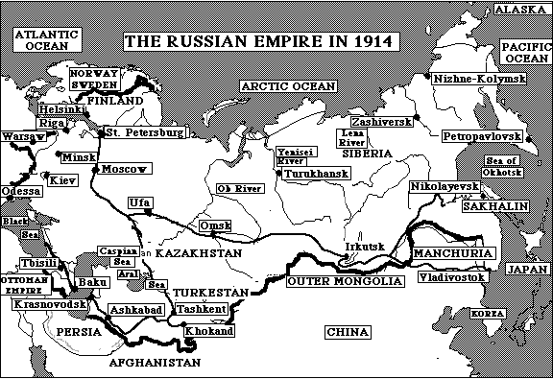
Russia Rearming
Russia’s military recovery from the Russo-Japanese War (1905-1905) was on pace to be completed in 1917. By then Russia would have a modern railway system that would invalidate many of the Schlieffen Plan’s assumptions about Russian slowness. Thus many German generals thought that war in 1914 was preferable to waiting because Russia would only grow stronger.

Slide 4
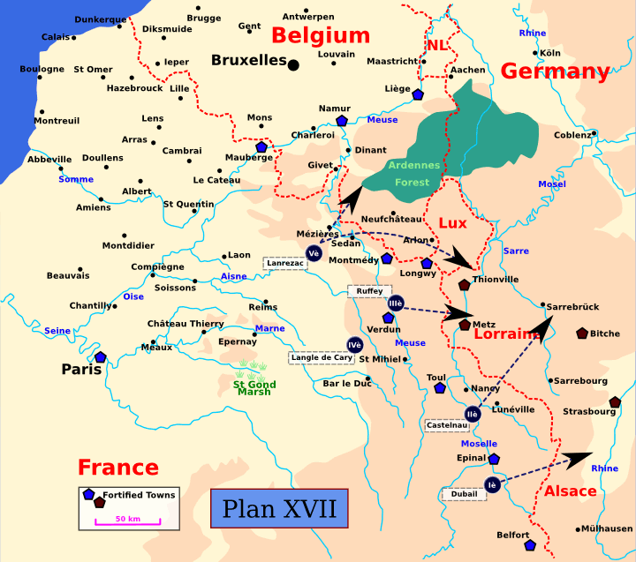
France and its Forts
France had invested heavily in a powerful belt of fortifications from Verdun to Toul to Epinal to Belfort. One of the forts at Verdun was the world’s strongest. The German Army knew it could not easily force its way through these forts. Thus it had to go around them, which meant invading Belgium.

Slide 5
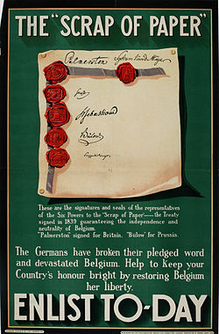
Belgian Neutrality
Belgium sat in a strategic and exposed position in Europe. Since an 1839 treaty signed by all the great powers, Belgium had been neutral, meaning that it belonged to neither alliance system. While all of its neighbors were willing to violate that neutrality if needed, only Germany’s war plan required it to do so. The Germans hoped to outflank the powerful French forts and gain control of the English Channel coastline.

Slide 6
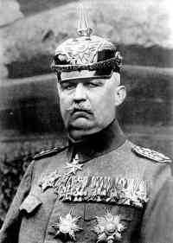
Belgian Forts
Belgium also had a series of strong forts which guarded the main Belgian rail lines. Germany needed control of those rail lines so they could supply the armies they planned to send into France. Belgium’s forts were so important that German officers like Erich Ludendorff (right) took his summer vacations there before the war, bicycling around the forts and making notes.

Slide 7
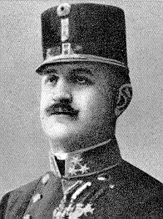
The Alfred Redl Scandal
In 1913, German agents discovered that Alfred Redl, one of Austria-Hungary’s senior intelligence officer, was a spy for Russia. Even though Redl killed himself rather than face a trial, the Germans shut off all joint military planning with their closest ally. The scandal, along with Germany’s lack of faith in its other ally, Italy, reinforced the German military’s fear that it was on its own against a range of enemies.

Slide 8
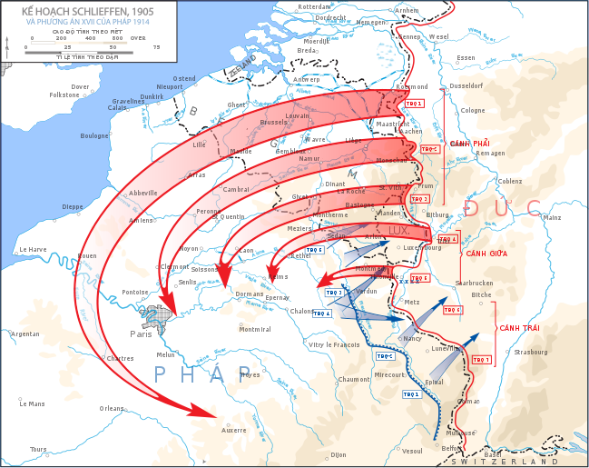
The Plan
Schlieffen retired in 1905. His successors kept the basics of the plan, assuming that Germany needed a quick (six weeks) victory over France before turning east to face the Russians, whom they presumed would be slower to mobilize. The plan required that everything go right. It also allowed for no alterations and demanded that Germany mobilize as quickly as possible. Speed was absolutely of the essence.

